Slide 1
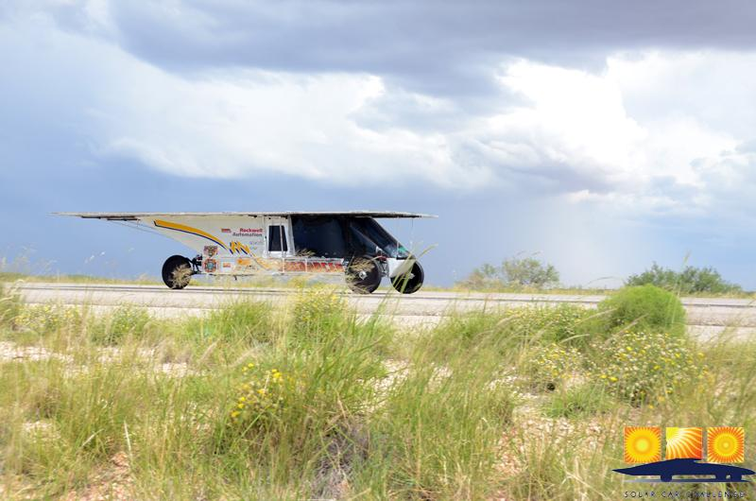
Things to Remember on a cross-country Race

Slide 2
We are all Ambassadors of this solar car race . . . we represent our teams, our schools, and our sport. Take time to visit with “the curious.”
It helps to designate one of your team members as a Public Information Officer. Let this person visit with bystanders

Slide 3
You will start and end the day with your Race Judge. You are responsible for their meals & well-being. They sit in the Chase Car Passenger Seat.
Treat your judge with respect and cooperation. Designate one of the team members to be a liaison to promote good judge/team communication.

Slide 4
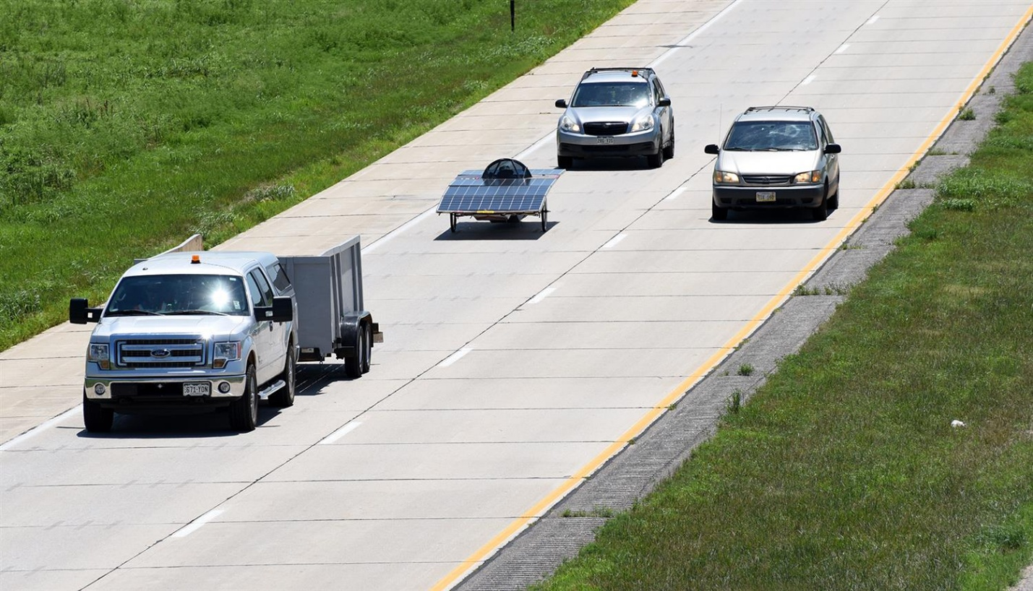
Keep your judge informed about your plans. A question asked before you do something “unwise” is always better than a penalty.

Slide 5
Be on time!
(1) Be on time for the 8:00 AM Drivers’ Meeting
(2) Be ready to line up your car according to starting order
(3) Be on time for meals
Teams arriving after the stated time in the “Where-to-Be” document are responsible for their own meals.

Slide 6
Be careful about what you say in public. Bystanders have been offended by thoughtless comments.

Slide 7
Driving Procedure
Be sure to take part in all Lunch Stops, Rest Stops, and Displays. If racing instructions indicate that solar cars will be driving into a Lunch Stop or Rest Stop, do your best to drive in to the “stop.” Visitors rarely get excited seeing a solar car on a trailer

Slide 8
Teams will drive from 9:00 AM to 5:00 PM, or as directed in the
Where-to-Be What-to-Do Document.
If a team has not reached the “End-of-Race Day” location by 5:00 PM, they must trailer their solar car at the next safe location and drive immediately to the End-of-Race Day location.

Slide 9
Cars unable to maintain 20 mph will be asked to pull over and charge their batteries, or trailer the solar car.

Slide 10
Teams should be aware of traffic building up behind the convoy.
If there are 4 or more cars building up behind the convoy, the solar car convoy must safely pull over to the shoulder to let traffic pass. Texas allows vehicles to drive on the shoulder.

Slide 11
The Secondary (No. 2) Chase Vehicle needs to travel at least five car lengths behind the Primary Chase Vehicle. This makes it easier for other vehicles to pass your convoy.
The Secondary Chase Vehicle should not pass another team at the same time as the rest of the Lead Vehicle-Solar Car-Primary Chase Vehicle convoy.

Slide 12
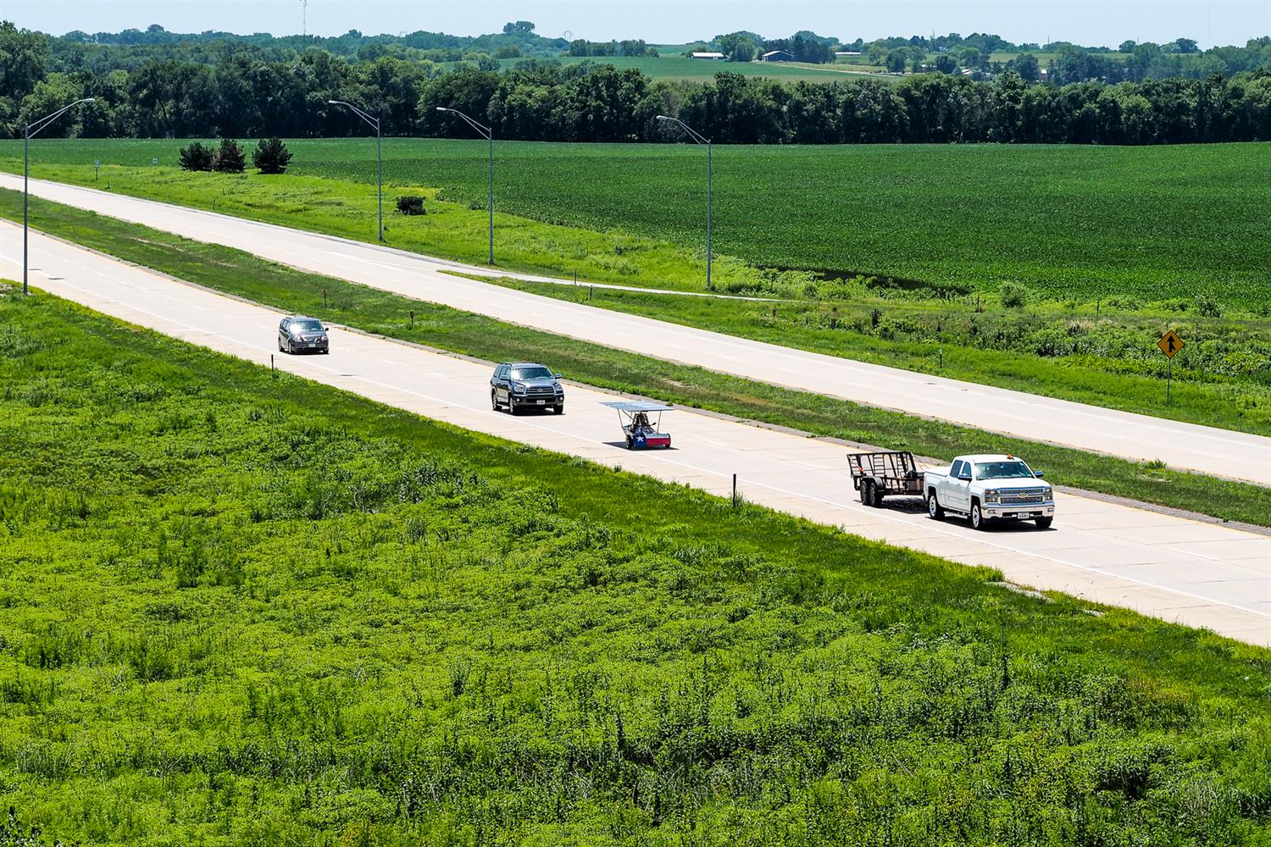

Slide 13
Passing
Pass another solar car with great care. Remember your vehicles have to pass all the other team’s vehicles!
Advise your Judge that you intend to pass another solar car!

Slide 14
The Primary Chase Vehicle must always stay with the solar car. Failure to do this will endanger the solar car and driver.
It is crucial that teams closely monitor their driving through intersections. If a team doesn’t think that the solar car and primary chase vehicle can make it through a light, then don’t do it! Don’t leave your solar car exposed.

Slide 15
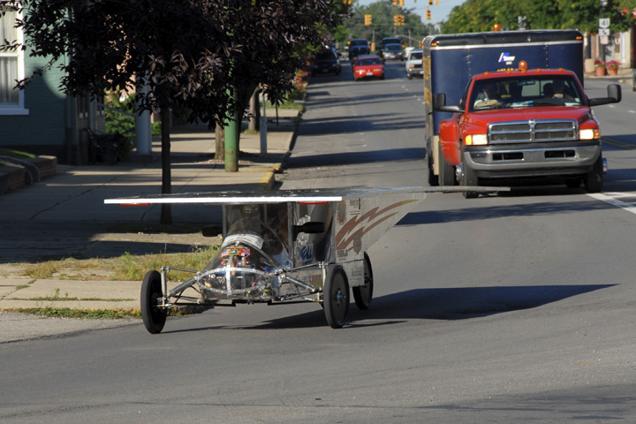

Slide 16
Only one vehicle trailer can be part of the Lead Vehicle-Solar Car-Primary Chase Vehicle-Secondary Chase Vehicle convoy.
Other vehicle trailers, including solar charging stations, if not part of the regular convoy, may not travel within one mile of the solar car.

Slide 17
WARNING LIGHTS
Make sure the Lead Car has a significant amber blinking light.
Make sure that each of the two Chase Cars have 4 ECCO lights facing to the rear!

Slide 18
Student Conduct
Students must conduct themselves properly at all times. This includes our time at the hotels.
We place great emphasis on good sportsmanship!
Teams are expected to support other solar car teams!

Slide 19
Safety Issues
We have to realize that onlookers, drivers, and media can drive in an unsafe manner to get a better look at a moving solar car. They are our paparazzi!
Teams need to drive defensively. Make sure that your Lead Car-Solar Car-Primary Chase Vehicle drive as a “unit.” Don’t allow an unsafe driver to cut in between the solar car and the First Chase Car.

Slide 20
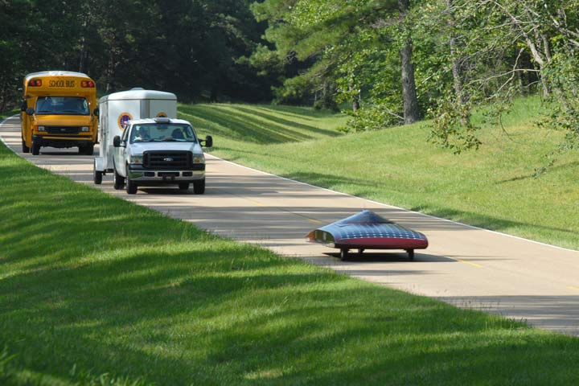

Slide 21
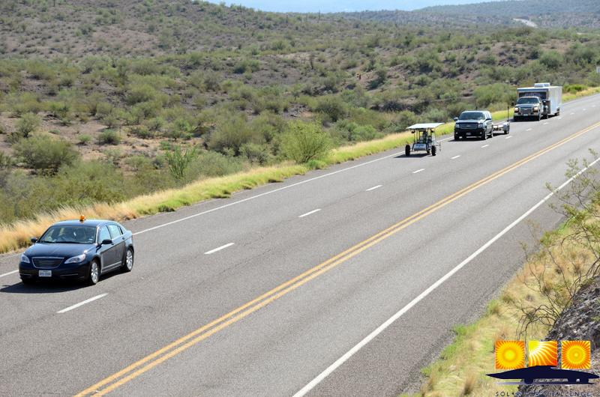

Slide 22
Continually monitor your solar car driver for heat issues. Rotate your drivers frequently! Take advantage of Rest/Lunch Stops.
All race participants must wear hats when in the sun. Drivers must wear closed-toe shoes and have a hat when they get out of the solar car!

Slide 23
The race recognizes that the ultimate responsibility for driving, team actions, and student conduct rests with the Adviser and/or School Representative. Having said this, the Race expects teams to follow the safety requests from Race Officials.
If any request appears to be too burdensome, teams are authorized to contact the Race Director for clarification

Slide 24
Impound Issues
Don’t remove a solar car from the Impound without a judge being present.
Your judge will be checking the following points each race morning:
(a) Battery seals and secure connections
(b) Driver Communication
(c) Brake lights and turn signals
(d) Safety Officer has necessary equipment
(e) Chase vehicle lights

Slide 25
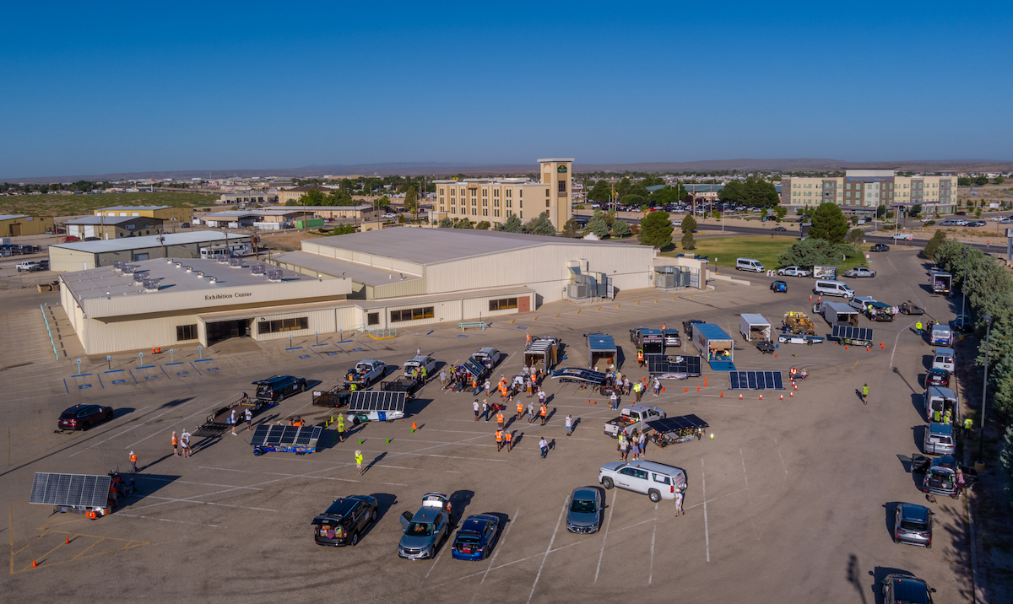

Slide 26
A Typical Race Day
6:30 AM Impound Opens [teams meet judge and get access to solar car]
8:00 AM Required Teams Meeting at Official Trailer
8:45 AM Solar Cars are lined up ready for Race Start
9:00 AM Race Start
10:30 AM Media or Rest Stop [15 minutes required]
12:30 PM Lunch Stop [30 minutes required]
2:30 PM Media or Rest Stop [15 minutes required]
5:00 PM Race Day Ends [trailer solar car if not at “end-of-race”]
7:00 PM Meal together with other teams
9:00 PM Impound begins [no access to solar cars]

Slide 27
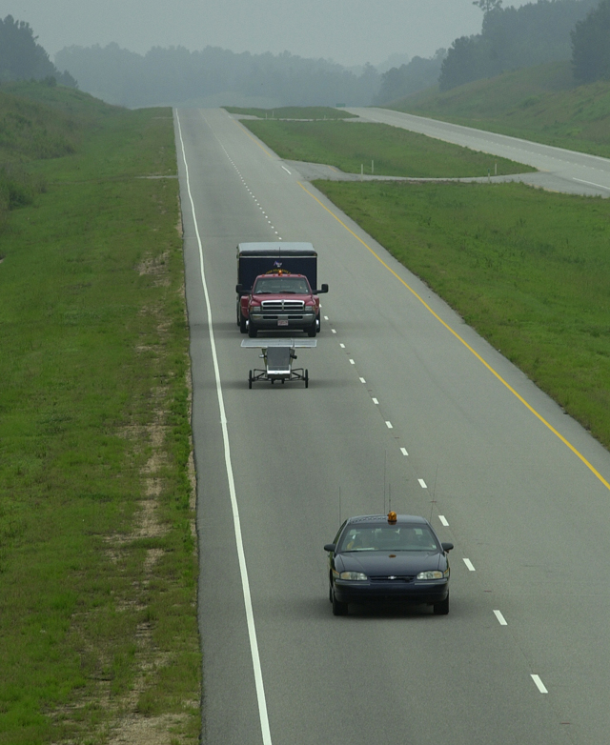
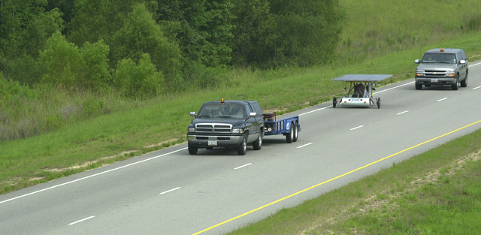

Slide 28
Penalties
Any team failing to comply with the regulations will be penalized.
Except for the last day of the event, all penalties will be posted at the Race Trailer by 12:00 PM the following day. On the last day of the event, penalties will be posted no later than one hour after the finish of the event.

Slide 29
Battery Penalties
A battery seal broken without official supervision, in a manner that would allow battery access, will result in the assessment of a 60 mile penalty

Slide 30
Charging
Any team using an alternative means to charge their main solar car batteries during the event (other than utilizing solar energy or regenerative brakes) will be disqualified.
Teams charging supplemental batteries are required to have an event official present to avoid any misunderstandings, and to prevent the application of this severe penalty.

Slide 31
Failure to Comply
Failure to comply with the mandatory stops during each day of the event will incur a 15 mile penalty for each infraction.
Teams should drive the two miles preceding and following the Starting Line, the Finish Line, Mandatory Stops, and specified cities, unless this is part of your driving strategy.

Slide 32
Traffic Violations – Any team committing a traffic violation will be penalized.
All non-moving traffic violations will result in a 2.5 mile penalty.
A moving traffic violation will result in a penalty ranging from 5 miles to disqualification.
Any driver who commits two moving violations over the course of the event will be disqualified to drive.

Slide 33
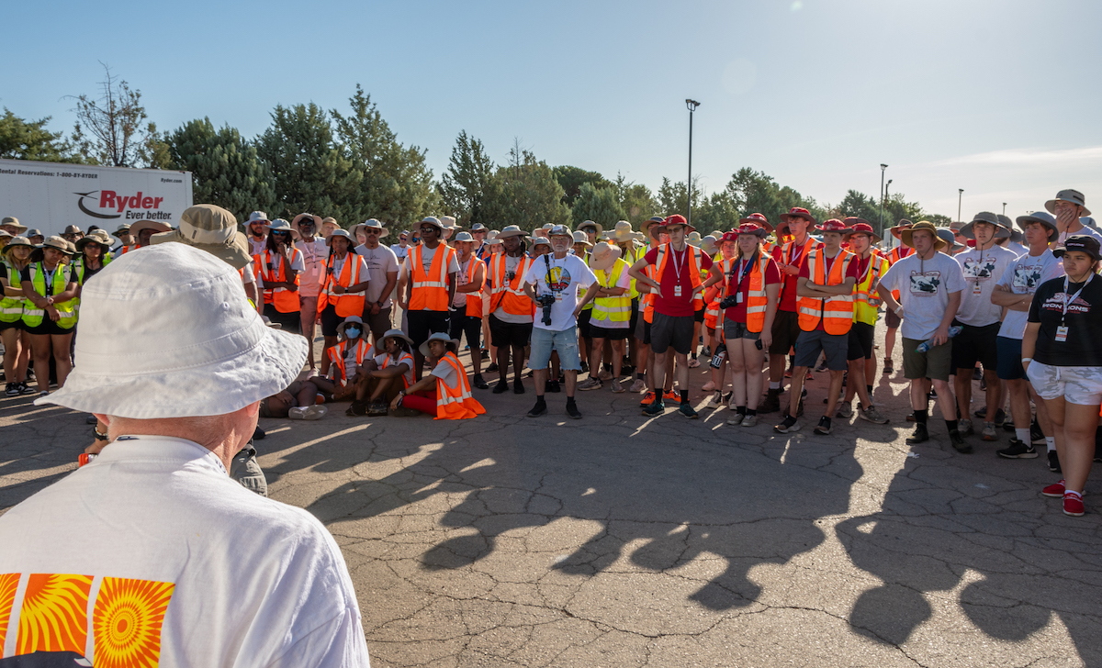
Failure to attend a Teams Meeting each day will incur a 10 mile penalty.

Slide 34
Conduct – An event official may assess penalties ranging from 2.5 miles to disqualification for improper or un-sportsman-like conduct.

Slide 35
Failure to Secure – Teams failing to secure loose equipment, on either the solar car or support vehicles when they are in motion, or onto the track/road may be penalized up to 5 miles.

Slide 36
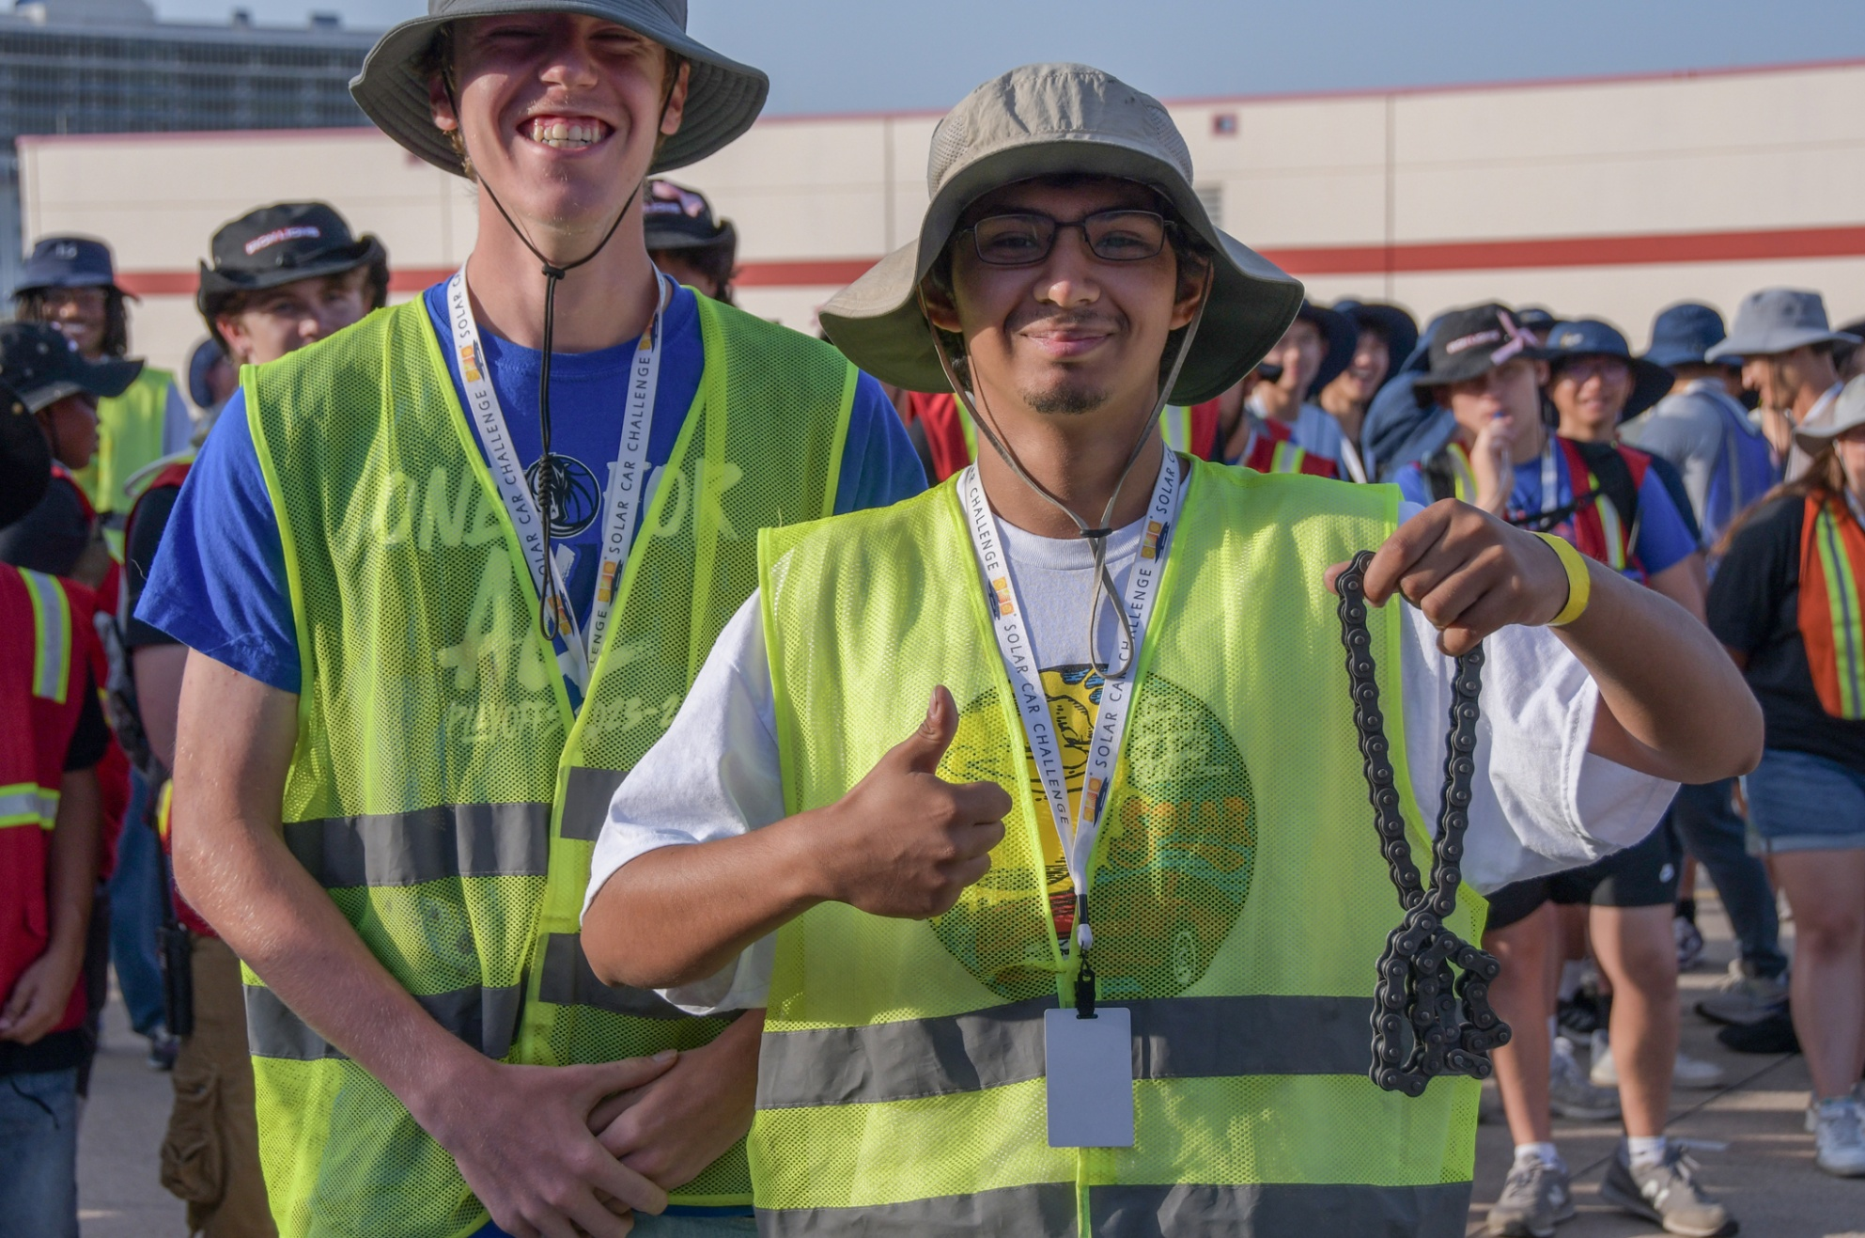

Slide 37
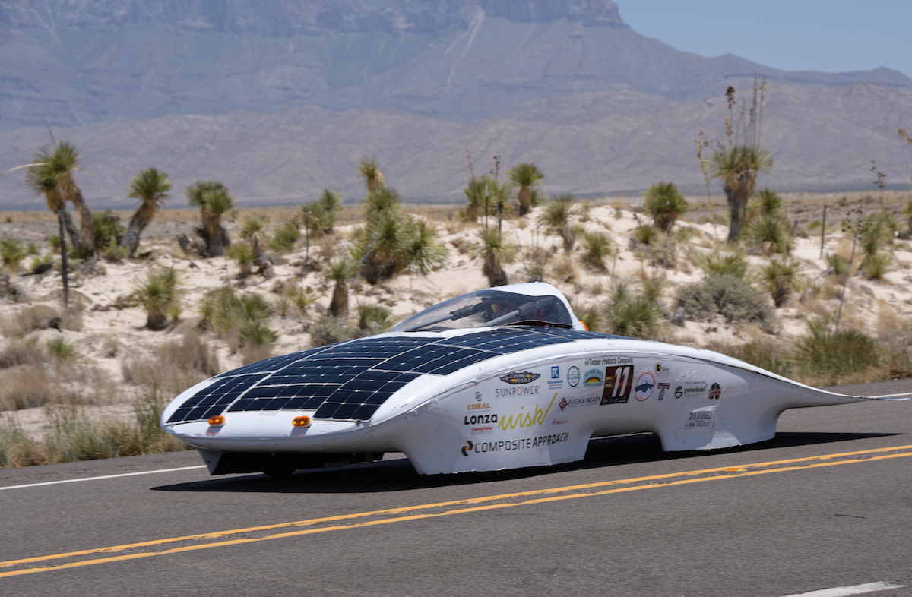

Slide 38
Maybe most importantly, put 500 miles on your solar car before you get to the Race.
You must have a strategy to handle mountains. Be sure you practice driving in MOUNTAINS.

Slide 39
You expect this kind of terrain . . .

Slide 40
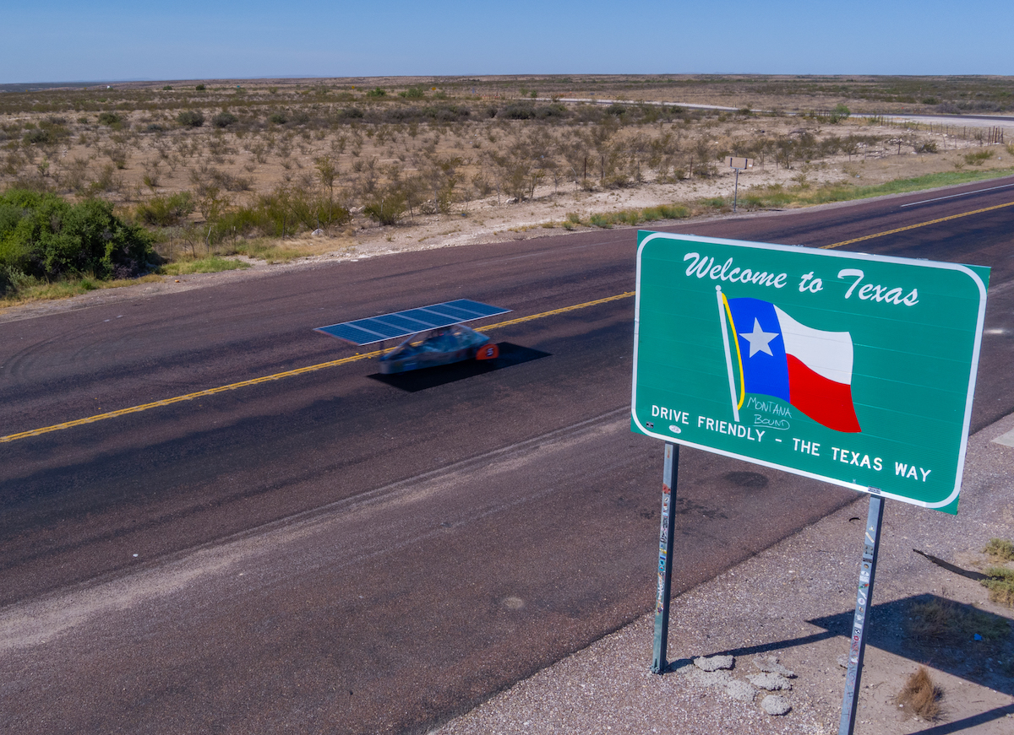

Slide 41
But you have to be prepared for this . . .

Slide 42
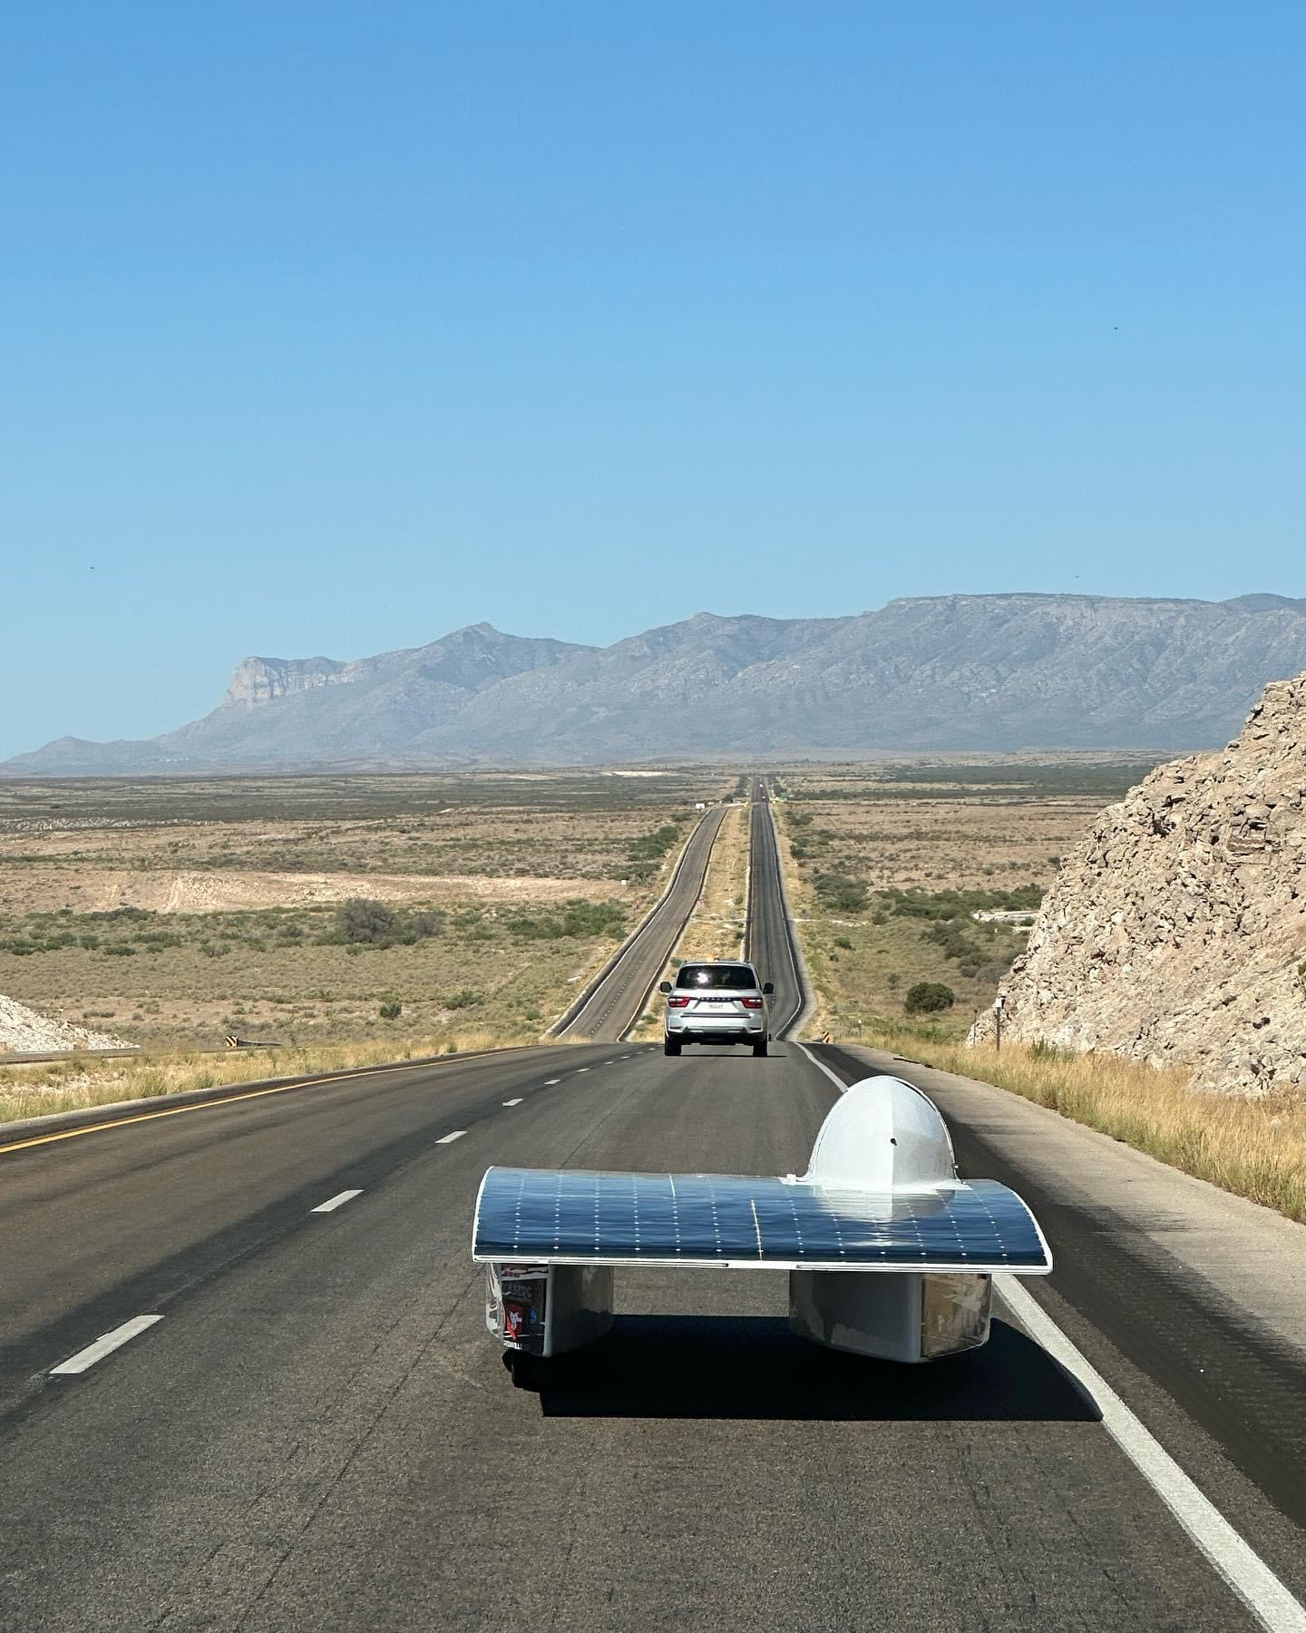

Slide 43
